Slide 1
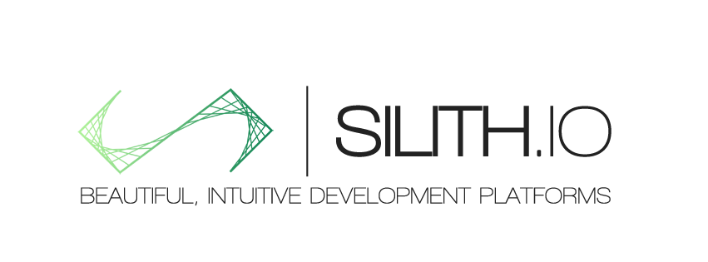
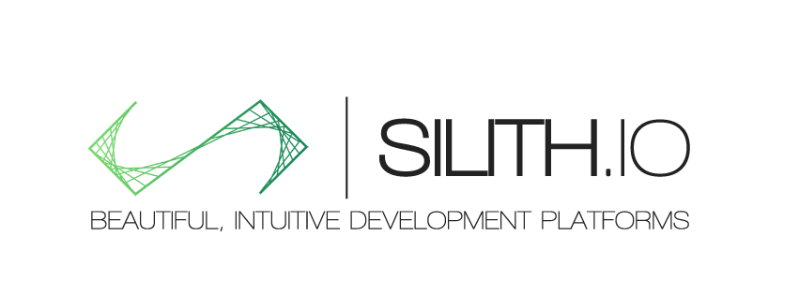
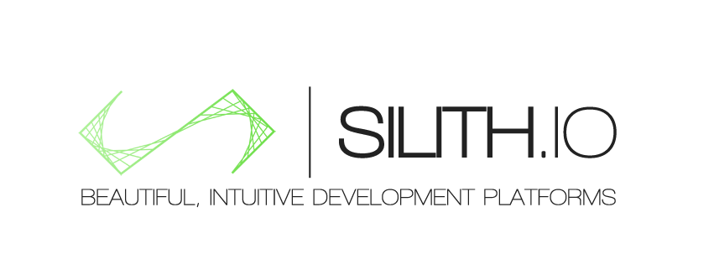
Notes:
Silith.IO – a mobile first company creating beautiful, intuitive platforms for application and business development

Slide 2
“No longer is it acceptable to build clunky software… No enterprise software segment is excluded from the threat of usable, beautiful innovation.”
Notes:
In today’s world, the existing enterprise software such as sharepoint, and even Jira can be upended by new intuitive and innovative platforms.
From spending time in Corporate america and managing teams around the globe, down to being an hour drive from a client and having to trade emails and screenshots on the progress of his application. I was not satisfied with the multiple platforms with gobs of information and poor user experience being used while we have hundreds of tools hitting the consumer space streamlining our interactions there.

Slide 3



Despite the advances and innovation in the social and mobile spaces
Notes:
When you use twitter, evernote, venmo, and more, you have an enjoyable experience with a slick UI on any device you want, why don’t we have this in the enterprise yet?

Slide 4
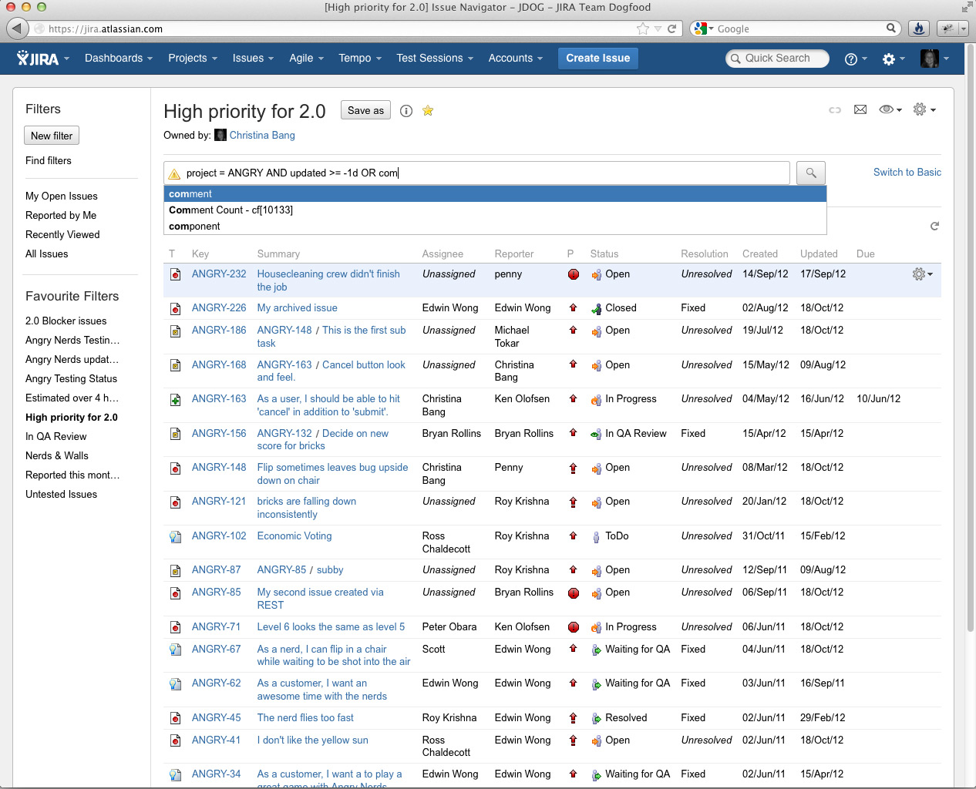
Enterprise is lagging behind
Notes:
The platforms in enterprise still largely look like this, a large bland list with excess of data

Slide 5
Beautiful, Intuitive Platforms
Notes:
Silith.IO was created to solve that issue, to allow you to run your business, improve your processes, from any device, any time, and on a beautiful intuitive platform.

Slide 6
$250 Million
Notes:
Our first target segment – The application development market – spends $250 million annually on PM, QA, and Prototyping Tools
THIS NUMBER IS RANDOM AND WE NEED THE REAL ONE

Slide 7
Most tools target PM, QA or Prototyping, thus creating the need to bounce around
We aim to take a different route and target the entire application development process with a simpler, design-focused approach
Notes:
Even w/ all the tools, you have multiple platforms for tasks, and QA and this and that, and people still send emails and have to follow up and tie other people in across platforms.
We aim to be a platform that focuses on great design to find what your team is working on, what you should be working on, and a single location for your team to communicate

Slide 8

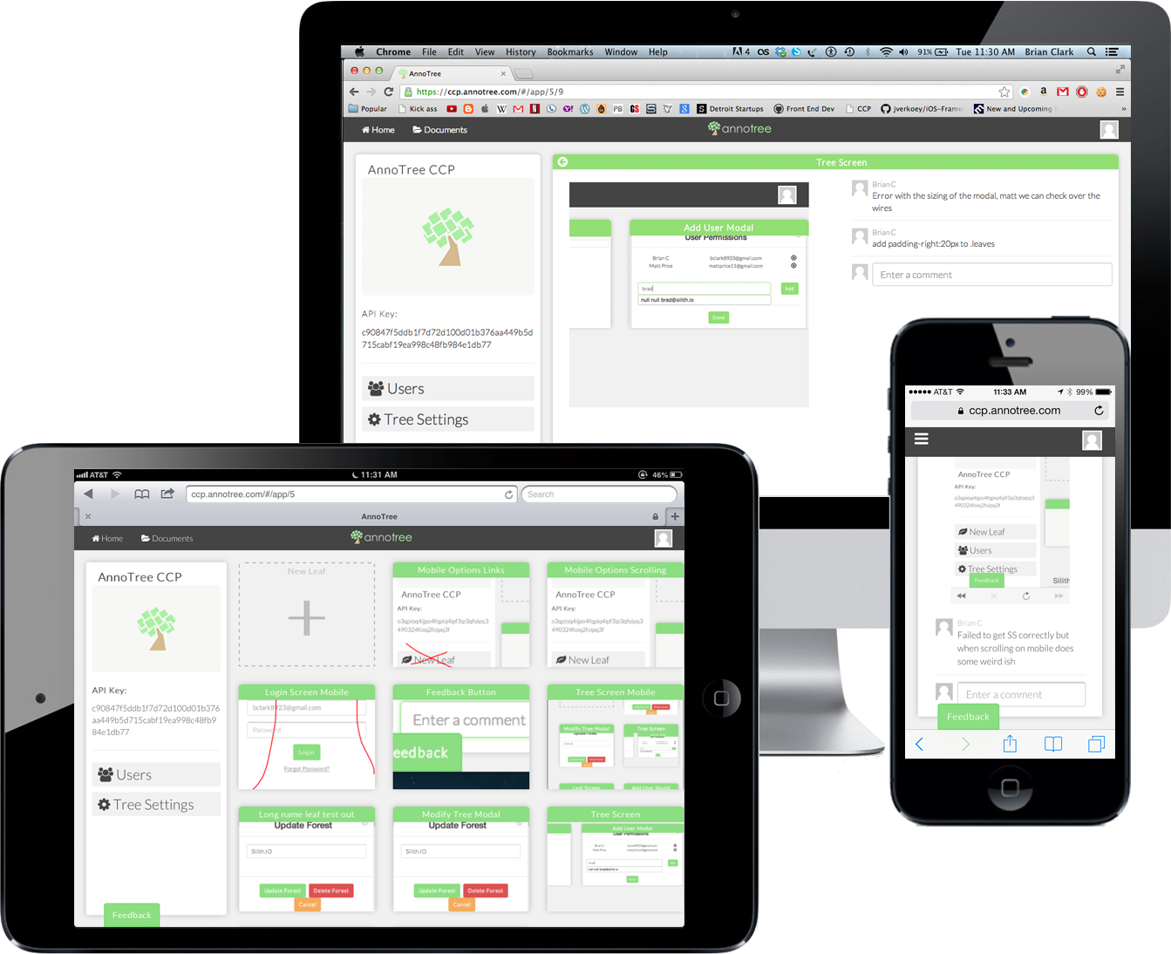

AnnoTree
Notes:
Thus we built annotree.
From any device you can create app mockups, annotate on your company website, or on your web and mobile apps, then send these back to our central collaboration platform where you and your team can collaborate on the entire application creation process from early designs and wireframes, to beta testing and production monitoring
1 2 3 HERE

Slide 9
Private Beta
60 Users
-Flock Tag, Ribbon, Forix Solutions
Expanding to Web and Android
Great response on the design and vision
Notes:
Early Metrics

Slide 10
“it really is a product that is needed in the mobile world”
Notes:
Real Customer Feedback

Slide 11
The Bigger Vision
Notes:
This first initial platform is a start and our key focus right now, but as we grow this platform out, we want to focus on bringing more business value to our users applciations and metrics and on how the users are using their apps and creating big data and visualization platforms around that information

Slide 12






Brian Clark
CEO
Matt Price
CTO
Brad Clark
Marketing
Shaun Nikore
Operations
Mike Max
Engineering
Accelerator -
Notes:
Team

Slide 13
$300k
Refine Existing Platform
Increase User Adoption
Launch Android
Notes:
Raising

Slide 14
CONTACT@SILITH.IO

